Slide 1
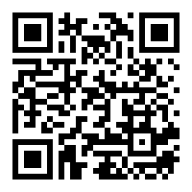



1
3
4
5
6
7
#######################
data_wrangling() &&
("manipulation" %in% R)
#######################
> ?when
[1] "Afternoons (~2hrs), 10—12 July"
> ?where
[1] "TBA"
> ?why
[1] "Postgrads who want to save time"
[2] "Tired of hours of copy-pasting in Excel"
[3] "Trying to figure out `tidyverse` R packages"
> ?who
[1] "Ruan van Mazijk (MSc candidate)”
[2] "ruanvmazijk@gmail.com"
🤳
RSVP here:
Brought to you by
the BioSci PG Committee
& iCWild
🐨🐟🌿 %>% %>% %>% 🤓📊🥰

